Slide 1



A Lot of Dissing – Manu’s PhD Thesis
Emanuel Berndl Chair for Distributed Information Systems
University of Passau

Slide 2
Three Pillars to Stand On
PhD Thesis
(Multimedia)
Metadata
Production, Consumption and Reclamation
Metadata Modeling
Experiments and Conclusions

Slide 3
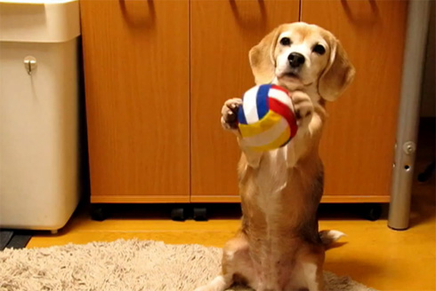
The Use Case – The MICO Project
Scenario:
You want to do a mega-cut dog video, with all the best dog videos out there
First steps include finding the videos
Search for “dog video”, “dog”, …
Is simple text search enough?
Semantic search would be awesome!

Slide 4
The MICO Approach
Tag Analyzer
Text Analyzer
Audio Analyzer
The MICO Platform
Video Analyzer
Metadata background for dog video

Slide 5
RDF – Resource Description Framework
Knowledge statements are represented as so called triples: <subject> <predicate> <object>
Many RDF features that we currently abstract from
Ultimately, the collected statements create a graph
Querying language: SPARQL
Dog
is-a
charlie
plays with
ball
has age
is-a

Slide 6
WADM – Web Annotation Data Model
Concept Web Annotation:
Body: The actual content of the annotation
Target: The thing that the annotation is about, can be extended with temporal/spatial fragments
Annotation: Connects body and target

Slide 7
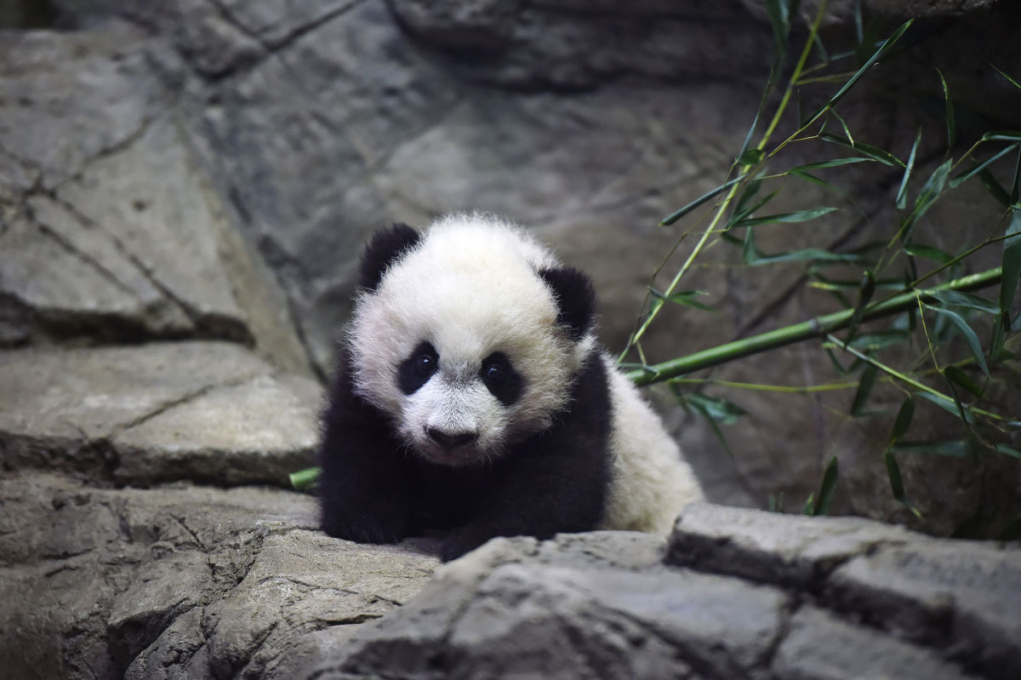
WADM – An Example

Slide 8
MMM – MICO Metadata Model
Supports a layer on top of the Web Annotations in order to provide traceability and interoperability
Form a combined metadata background for one given multimedia item
Various different features possible

Slide 9
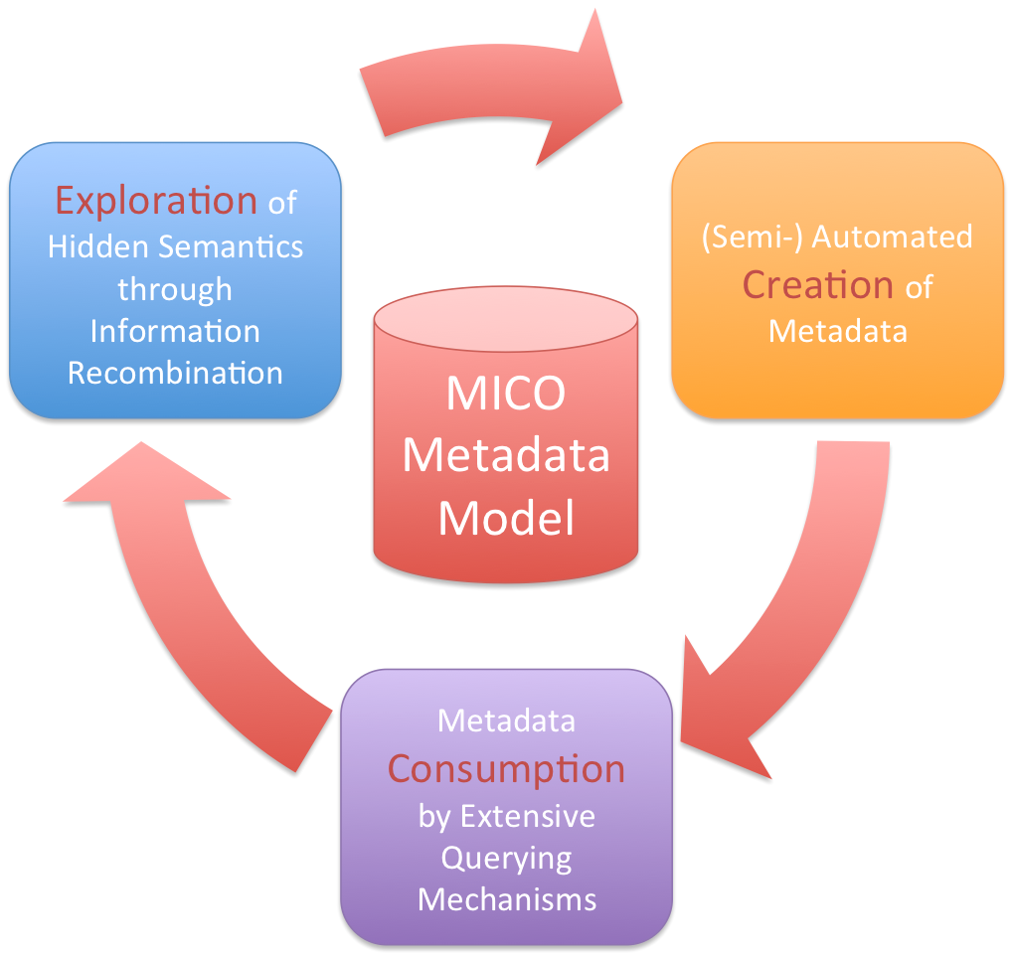
Production, Consumption and Reclamation

Slide 10
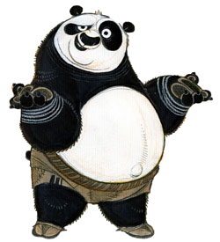
The MICO Approach
RD… what? And who or what is that Spackl you are talking about?
Tag Analyzer
Text Analyzer
Audio Analyzer
The MICO Platform
Video Analyzer
Metadata background for dog video

Slide 11

Programmatic access to reading and writing Web Annotations from and to SPARQL-endpoints
Useable “without” RDF or SPARQL experience
Hibernate-like mapping between RDF objects and Java Objects
Extensible design
Usable with any SPARQL 1.1 endpoint
Apache License 2.0 → github.com/anno4j/anno4j
Core library (smaller tweaks implemented):
OpenRDF Alibaba¹ (former Elmo codebase)
Features:
Graph context
Transactions
Extensions/Plugins
Persistence
Querying
Notes:
ORM Object Relational Mapping -> ORM Object RDF Mapping

Slide 12
Experiments
What to do with the metadata?
Why is it totally awesome to have them?
Initial ideas: Recommenders
Based on diverse features that can be represented in the metadata model
Based on “graph structure”
“Step by step” information gain

Slide 13
Experiments – Ideas from the awesome PGBBS people
Take similarity search benchmark datasets and try to use the MMM for that reason
Results must not be as good, just in the direction, as the focus is not the extraction quality
Konstantin: data present in varying data formats, e.g. financial data
MMM as possibility to funnel and make the data comparable and useable together

Slide 14
Recap

Slide 15
Persistence – Custom Model
@Iri(http://www.example.com/schema#AnimalBody)
public interface AnimalBody extends Body {
@Iri(RDF.VALUE)
String getAnimal();
@Iri(RDF.VALUE)
void setAnimal(String animal);
@Iri(EX.CONFIDENCE)
Double getConfidence();
@Iri(EX.CONFIDENCE)
void setConfidence(Double confidence);
}
Creating a Java class (with respective example values) leads to the following RDF triples:
<urn:body> a ex:AnimalBody ;
rdf:value “panda” ;
ex:confidence 0.95 .
Notes:
Nicht nur Annotationen sind möglich, komplett eigenes Modell kann erstellt werden

Slide 16
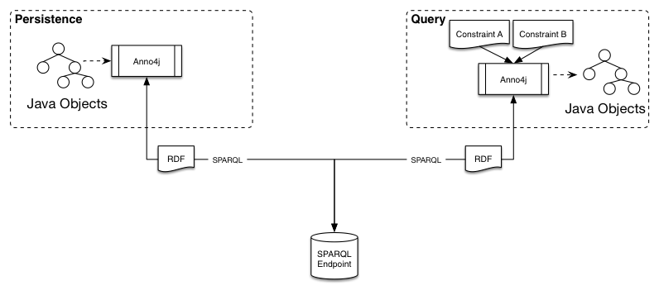
Persistence – Anno4j Workflow
// Setup Anno4j instance
Anno4j anno4j = new Anno4j();
anno4j.setRepository(new SPARQLRepository(“http://www.mydomain.com/sparql”));
anno4j.setIdGenerator(new MyIDGenerator());
// Create the Annotation
Annotation anno = anno4j.createObject(Annotation.class);
anno.setMotivatedBy( ... );
anno.setSerializedAt( ... );
// Create and attach the Body
AnimalBody body = anno4j
.createObject(AnimalBody.class);
body.setAnimal(“panda”);
body.setConfidence(0.95);
anno.setBody(body);
Notes:
PROXY – für mehrere RDF Klassen nötig, Partials – bei .createObject() nur kurz erwähnen
Bild weg?

Slide 17
Querying
Queries via Anno4j are done using the path-based query language LDPath¹
Query for information on an RDF graph
More convenient to non-RDF experts
Transformed to an equivalent SPARQL 1.1 query
Fluent interface supported for querying
LDPath examples
Path Traversal: oa:hasBody/rdf:value
Reverse Path: ^oa:hasTarget
Types: ex:predicate[is-a ex:AnimalBody]
Datatypes: ex:doubleValue[^^xsd:double]
Languages: ex:langValue[@en]
Grouping & Unions: (ex:pred1/ex:pred2) | ex:pred3
¹http://marmotta.apache.org/ldpath/
Notes:
Add criteria constraint by constraint

Slide 18
Querying – Example
// Setup QueryService
QueryService qs = anno4j.createQueryService();
qs.addPrefix(“ex”, “http://www.example.com/schema#”)
.addCriteria(“oa:hasBody[is-a ex:AnimalBody]”)
.addCriteria(“oa:hasBody/rdf:value”, “panda”)
.addCriteria(“oa:hasBody/ex:confidence”, 0.8, Comparison.GTE);
// Query for Annotations
List<Annotation> result = qs.execute(Annotation.class);

Slide 19
Additional Features
LDPath criteria(s)
directly mapped to
equivalent
SPARQL 1.1 query
Extensions/Plugins
Support custom LDPath function + query logic
Transactions (beta)
Transactional behavior can be used with the triplestore
Set of actions: commit or rollback
Basic behavior: Auto-commit
Graph Contexts / Subgraphs
Lazy evaluation for faster and more efficient querying

